Slide 1
Cinema Selector
By: Kathy Saldana & Katia Daly
https://github.com/Etown-CS310/Cinema_Selector

Slide 2
Project Overview and Progress
Cinema Selector helps users decide what to watch by recommending movies based on their watch history and saved preferences.
Milestone 1
Now
A front-end prototype built with static HTML pages
Movie data hardcoded
Movies picked at random
No data saved between visits
Movie database: 200 movies loaded from TMDB API into SQLite
Backend API: a Node.js and Express server
Login with Firebase Authentication
Improved features
Notes:
Purpose and intended users. Mention that this milestone is front-end only: sample data in a JS array, no backend/database yet.

Slide 3
System Architecture
Frontend
HTML, CSS, JS
Live Server, Port 5500
Backend
Node.js + Express
Port 3000
Database
SQLite
movies.db
Firebase
User login
TMDB API
Movie data via seed.js
Notes:
Walk through the layout of the Randomizer and Watch History pages and how a user moves between them.

Slide 4
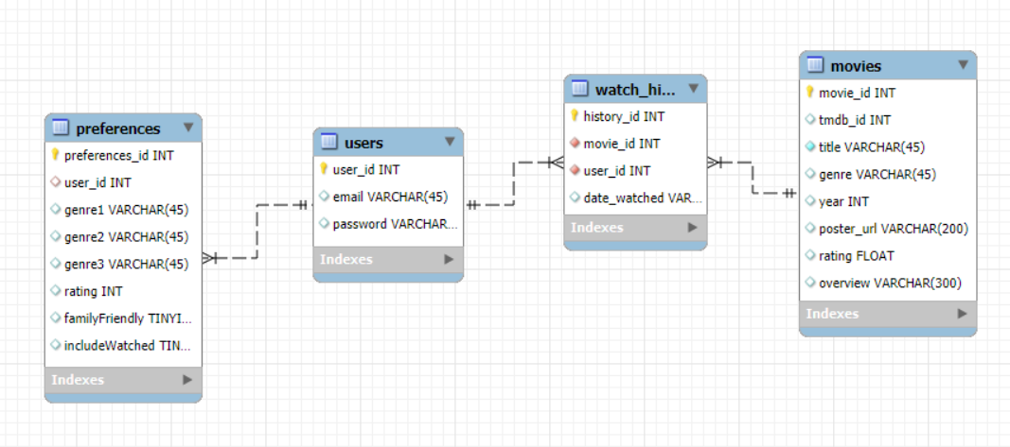
Database Design
Notes:
Walk through the layout of the Randomizer and Watch History pages and how a user moves between them.

Slide 5
Implemented APIs
The APIs that we are implementing are:
TMDB - The Movie Database
  This API provides all of our movie information, fueling movie recommendations and serving as our movie library.
Firebase Authentication
  This API provides our user authentication and stores it securely.
Our HTTP Methods
  7 endpoints (consisting of GET, POST, DELETE, PUT)
  Used for /movies, /preferences, /history, /api/firebase-config
  Features: get all movies, get watch history, mark a movie as watched, remove from history, load preferences, save preferences, login configuration

Slide 6
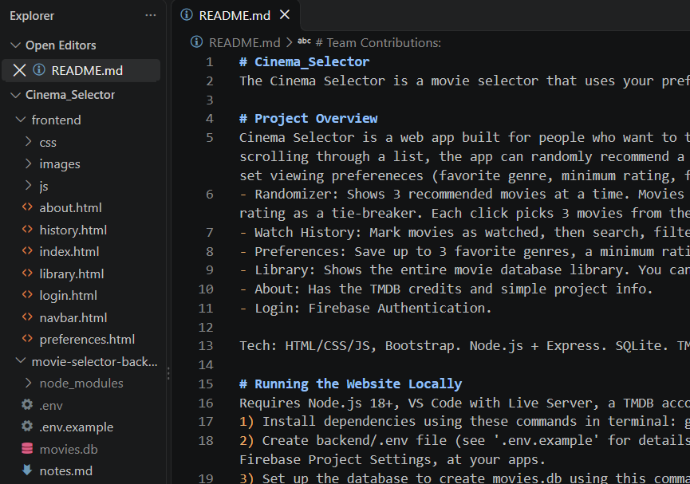
Team Contributions
Both:
Styling and fetch calls() for their pages
Adding tables to the database
Kathy:
Design and functionality of the watch history and randomizer pages
Movie database and API configuration
Katia:
Design and functionality of the library and preferences pages
Login and Firebase authentication

Slide 7
LIVE DEMO

Slide 8
Technical Challenges
Limitation: TMDB’s popular list doesn’t include certifications (PG, R), so family-friendly is approximated by genre.
Multi-genre movies breaking the genre filter (fixed with .includes()).
Trouble connecting Firebase to our movies.db
Keeping the CSS styling page consistent.

Slide 9
Next Steps
Priorities for Finishing:
Linking data to each user: right now history is shared, and preferences uses a temporary user id (TODO: replace TEMP_USER_ID).
Style login page more
Deployment
Goal: A complete, personalized movie recommender where every user has their own account, watch history, and preferences.

